Slide 1
QR CODE
SLIDE 1 – Idiomas
SLIDE 2- Índice productos
SLIDE 2- SLIDE 3 – Producto a producto

Slide 2
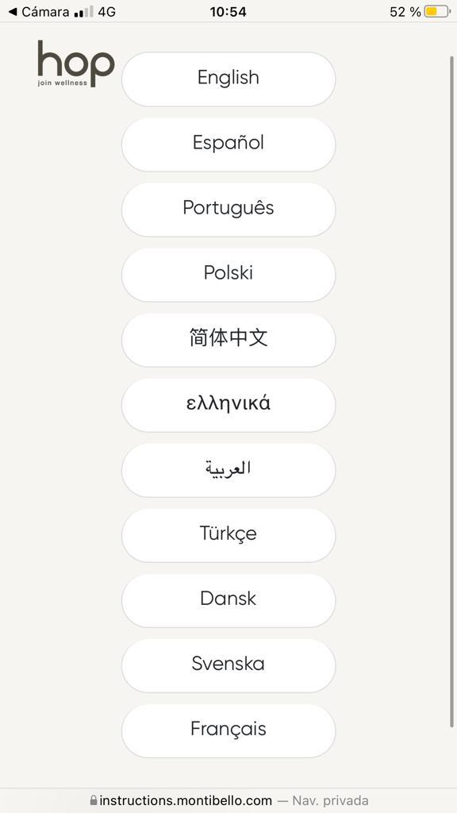
SLIDE 1:
Mismo diseño y mismos idiomas

Slide 3
SLIDE 2- Índice productos
INTENSIFIER - Base for fine to medium hair
INTENSIFIER - Base for medium to coarse hair
RECHARGE - Strengthening Concentrate
RECHARGE - Colour Concentrate
RECHARGE - Smoothing Concentrate

Slide 4
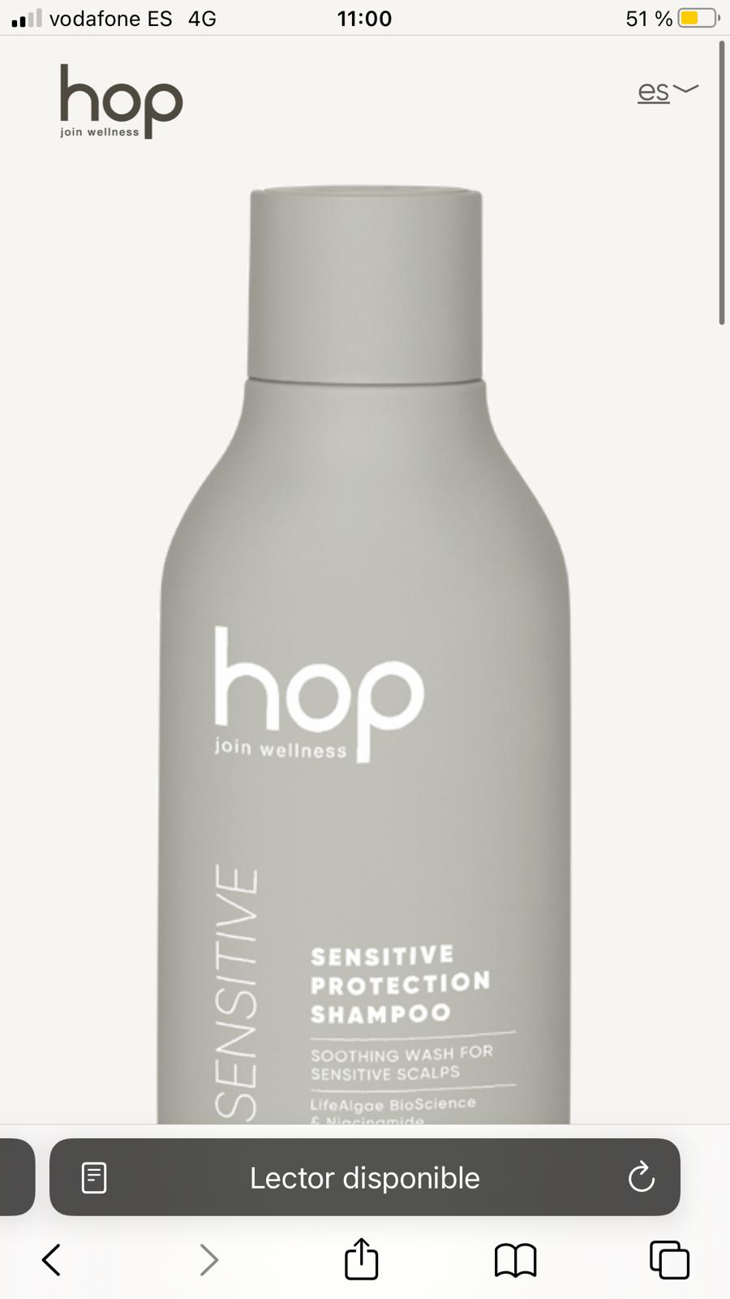
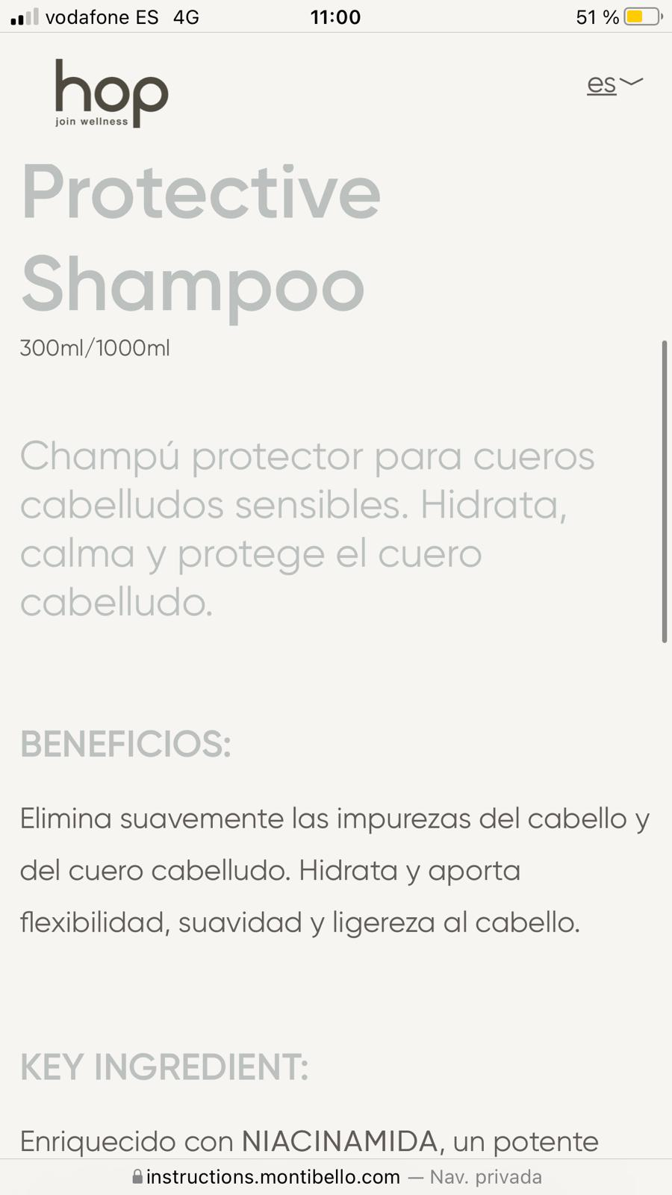
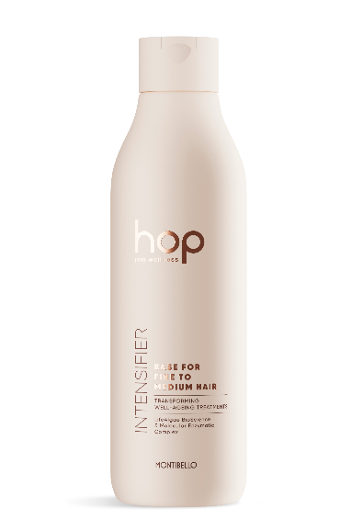
SLIDE 3- Producto a producto
INTENSIFIER - Base for fine to medium hair
The Intensifiers are the cornerstones of the TRANSFORMING WELL-AGEING treatments, designed to prevent accumulated damage in hair, condition and hydrate hair, as well as intensify the action of the concentrates.
Formulated with Molecular Enzymatic Complex, based on a restorative complex of bioenzymes of natural origin, it strengthens the hair’s internal structure, provides deep hydration, smooths the hair cuticle and restores the outermost layer creating a protective shield. It works together with seaweed bioscience, LifeAlgae BioScience, which magnifies the power of the actives to boost their results in hair.
Benefits:
• Restores and strengthens the hair’s internal structure
• Humidity-proofs hair and smooths the hair cuticle
• Improves texture and provides intense hydration
5X SOFTER
4X LIGHTER AND MORE MANAGEABLE
80% MORE REPAIRED AND HEALTHIER
Key ingredients:
· Complex of natural origin that reinforces the structure of the hair from within penetrating into the cortex, balances moisture in hair, improves its mechanical properties and repairs damage caused by ultraviolet radiation.
· Multifunctional polymeric UV filter that conditions and protects the hair shaft from loss of colour.
· Pro-Vitamin B5 that penetrates into the hair shaft, hydrates it and helps it retain moisture.
Directions for use:
Based on a prior diagnosis, the professional combines the two steps – Intensifier & Recharge – in the applicator bottle. The blend is applied to hair after washing, leaving it to work for 7 minutes.
Same structure

Slide 5
SLIDE 3- Producto a producto
INTENSIFIER - Base for medium to coarse hair.
The Intensifiers are the cornerstones of the TRANSFORMING WELL-AGEING treatments, designed to prevent accumulated damage in hair, condition and hydrate hair, as well as intensify the action of the concentrates.
Formulated with Molecular Enzymatic Complex, based on a restorative complex of bioenzymes of natural origin, it strengthens the hair’s internal structure, provides deep hydration, smooths the hair cuticle and restores the outermost layer creating a protective shield. It works together with seaweed bioscience, LifeAlgae BioScience, which magnifies the power of the actives to boost their results in hair.
Benefits:
• Restores and strengthens the hair’s internal structure
• Humidity-proofs hair and smooths the hair cuticle
• Improves texture and provides intense hydration
5X SOFTER
4X LIGHTER AND MORE MANAGEABLE
80% MORE REPAIRED AND HEALTHIER
Key ingredients:
· Complex of natural origin that reinforces the structure of the hair from within penetrating into the cortex, balances moisture in hair, improves its mechanical properties and repairs damage caused by ultraviolet radiation.
· Multifunctional polymeric UV filter that conditions and protects the hair shaft from loss of colour.
· Pro-Vitamin B5 that penetrates into the hair shaft, hydrates it and helps it retain moisture.
Directions for use:
Based on a prior diagnosis, the professional combines the two steps – Intensifier & Recharge – in the applicator bottle. The blend is applied to hair after washing, leaving it to work for 7 minutes.
Same structure

Slide 6
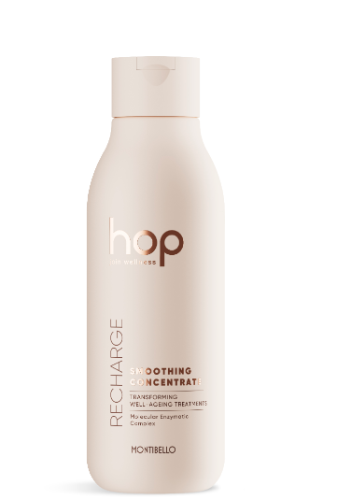
SLIDE 3- Producto a producto
RECHARGE - STRENGTHENING CONCENTRATE
Concentrate for fragile and/or damaged hair, formulated with amino acids and moisturising factors for intensive restructuring of the innermost layers of hair and protection against breakage.
Benefits:
• Restores the hair’s internal structure
• Prevents breakage
• Adds strength and elasticity to the hair shaft
Key ingredients:
· Potent fortifying complex with dual action, which penetrates into the hair shaft to increase its resistance to breakage and coats it to lubricate and restore the hair cuticle.
· Blend of amino acids that interact with hair, strengthening the structure of the hair shaft and repairing the damage on the surface to increase its elasticity and resistance.
Directions for use:
Based on a prior diagnosis, the professional combines the two steps – Intensifier & Recharge – in the applicator bottle. The blend is applied to hair after washing, leaving it to work for 7 minutes.
Same structure

Slide 7
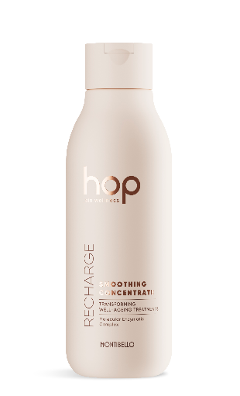
SLIDE 3- Producto a producto
RECHARGE - SMOOTHING CONCENTRATE:
Concentrate for unruly, frizzy and/or curly hair, formulated with agents that seal the hair cuticle, neutralise electrostatic charges and serve as a protective barrier to lock in moisture and repairing active ingredients.
Benefits:
• Improves softness
• Keeps hair hydrated
• Gets rid of frizz
Key ingredients:
· Plant-based natural sugar complex that hydrates hair while creating a barrier around the hair shaft that prevents the loss of moisture.
· Conditioning agents and natural humectants that soften, reduce the strength of hold in styling, restore the hydrophobicity of hair, provide excellent anti-frizz properties and help to repair split ends.
Directions for use:
Based on a prior diagnosis, the professional combines the two steps – Intensifier & Recharge – in the applicator bottle. The blend is applied to hair after washing, leaving it to work for 7 minutes.
Same structure

Slide 8
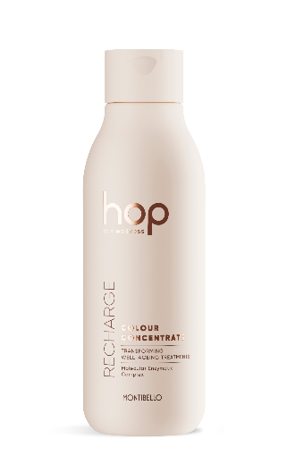
SLIDE 3- Producto a producto
RECHARGE - COLOUR CONCENTRATE:
Concentrate for colour-treated hair, formulated with natural antioxidants, shine enhancers and colour sealing polymers to improve brightness, make hair colour last longer and protect it from oxidative stress.
Benefits:
• Makes hair colour last longer
• Protects against radiation
• Enhances the vibrancy and shine of hair
Key ingredients:
· Natural antioxidants from green tea that protect hair from loss of colour due to oxidation from both the formation of free radicals and the effect of UV radiation.
· Quaternised polymer that evenly coats the hair shaft, creating a protective film that protects it against loss of colour from washing.
Directions for use:
Based on a prior diagnosis, the professional combines the two steps – Intensifier & Recharge – in the applicator bottle. The blend is applied to hair after washing, leaving it to work for 7 minutes.
Same structure

